Slide 1
A Time-Domain Short Circuit Study for a VSC Based Battery Energy Storage System
Ahmad Abdullah, Ph.D. Muhammad Humayun, Ph.D. Carl Moeller David Mueller, P.E. Mortenson EnerNex

Slide 2


Slide 3


Slide 4


About EnerNex, a CESI Company
Founded in 2003, EnerNex is a leader in providing engineering, consulting, and research services to the electric power industry worldwide
Joined the world-leading electric power testing, consulting and engineering company CESI in June 2018
Our focus is the electric grid and helping clients solve complex challenges
The EnerNex team is comprised of experienced power engineers, control systems professionals, program managers, and regulatory and business experts

Slide 5

EnerNex Service Areas
We address the complex challenges of the electric utility industry by offering services that span from detailed engineering analyses to strategic guidance
Our wide-range of services enables us to provide broad contextual perspective to best resolve the specific needs of our client partners
TACTICAL PERSPECTIVE
STRATEGIC PERSPECTIVE
Electric Energy Systems
Engineering
&Analysis
Renewable & Distributed Energy Integration & Interconnection
Electric Energy Systems
Engineering
& Analysis
Renewable & Distributed Energy Integration & Interconnection
Grid Technology Consulting
Grid
Modernization
Electric Industry
Evolution
Grid Technology Consulting
Grid
Modernization
Transmission & distribution utility studies, complex modeling & simulation
Solar & wind modeling, integration & interconnection studies
Cybersecurity, IEC 61850, utility procurement assistance, vendor due diligence, pre-certiﬁcation testing, communications, cyber assurance
AMI, ADMS, DERMS, DR, enterprise architecture, microgrids, grid modernization, roadmaps
Strategic planning, business case
development,
change management, regulatory support
REPRESENTATIVE
TYPES OF WORK
5

Slide 6

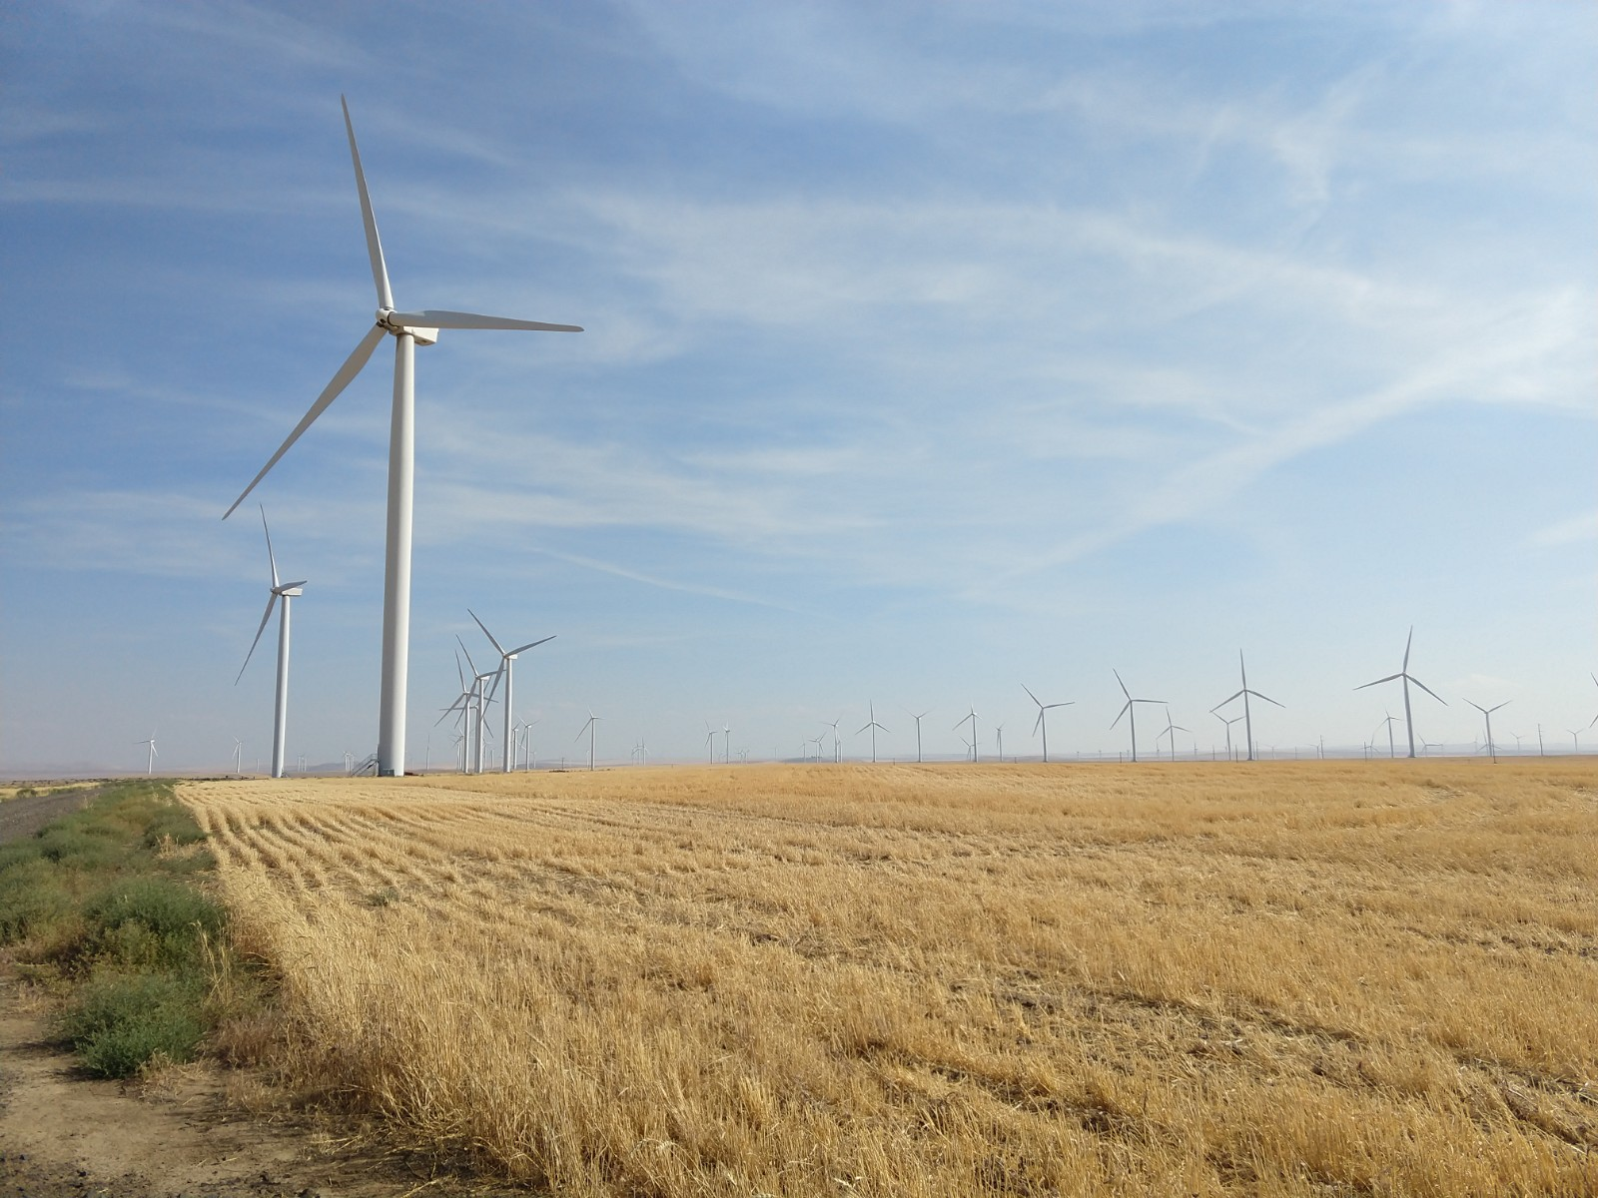
Renewable & Distributed Energy Integration & Interconnection
Helping our clients understand the impact of integrating intermittent resources in distribution and transmission systems
Service Areas
Solar converter and wind turbine modeling
Wind and solar integration studies
Renewable plant interconnection studies
Energy storage integration
Representative Projects
DTE Energy | DER Interconnection Study and CYME Support
DSTAR | Evaluation of Power Control Devices for Increasing DER Hosting Capacity
Mortenson-AES Corporation | 485 MW ac Spotsylvania Solar Energy Center | Power System Studies

Slide 7
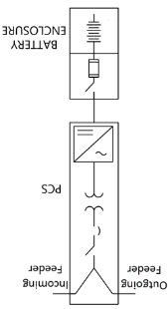
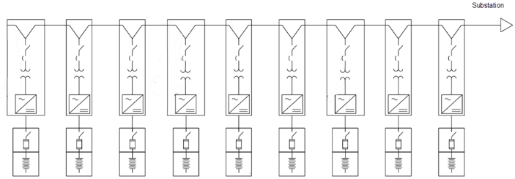
Project Description
Large 204 MW Plant with BESS and PV solar connected at 230 kV
68 Power Conversion Units (PCU), each at 3.45 MVA (0.633/34.5 kV)

Slide 8
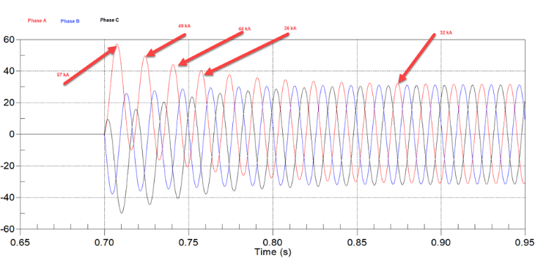
Fault Current Calculation to Determine Switchgear Ratings
Commercial fault calculation software are based on the methodology of IEEE ANSI C37.010-1979 was included in the IEEE “Violet Book.”
“IEEE Application Guide for AC High-Voltage Circuit Breakers > 1000 Vac Rated on a Symmetrical Current Basis,” IEEE Std C37.010-2016
The related content from the IEEE Violet book is now “IEEE Recommended Practice for Conducting Short-Circuit Studies and Analysis of Industrial and Commercial Power Systems,” IEEE Std 3002.3-2018.

Slide 9
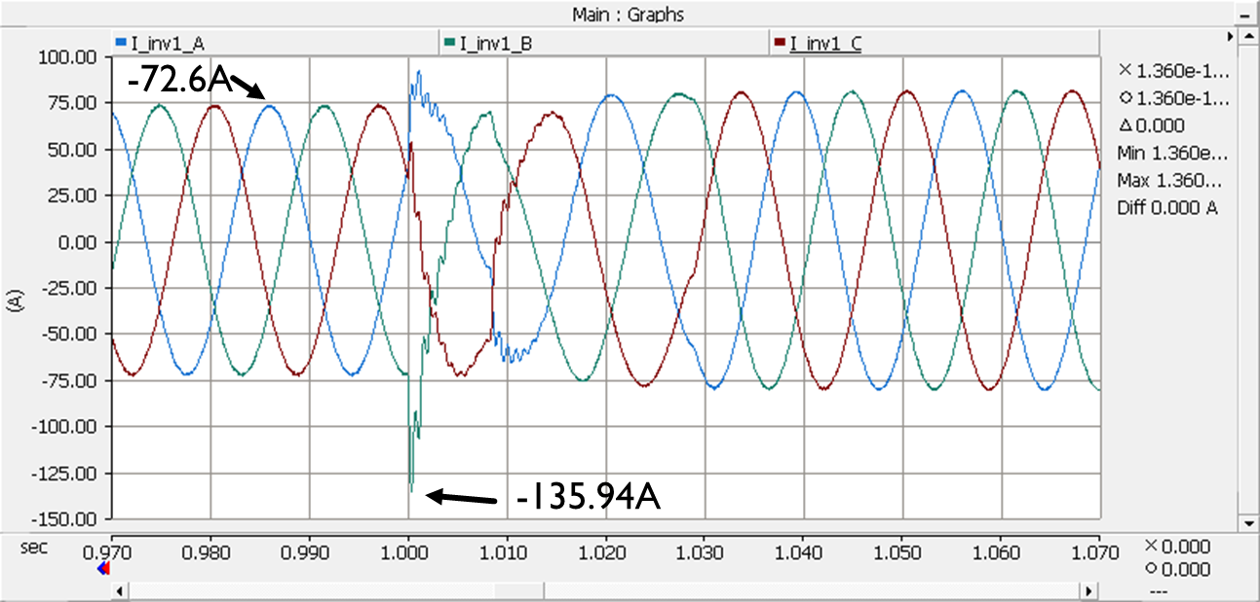
Single Inverter Fault Response

Slide 10
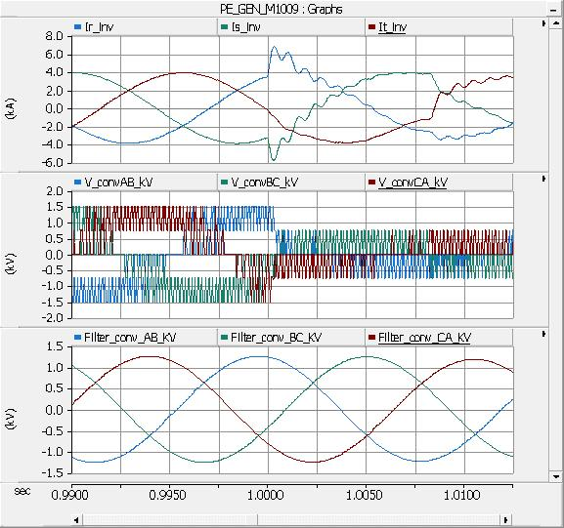
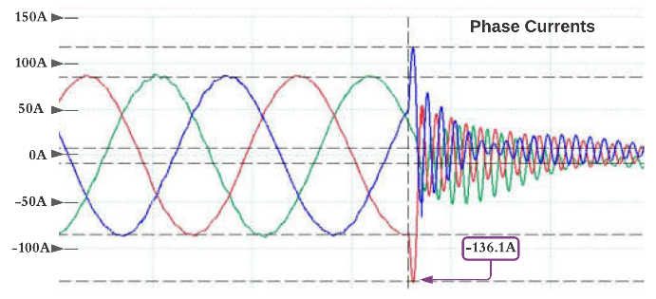
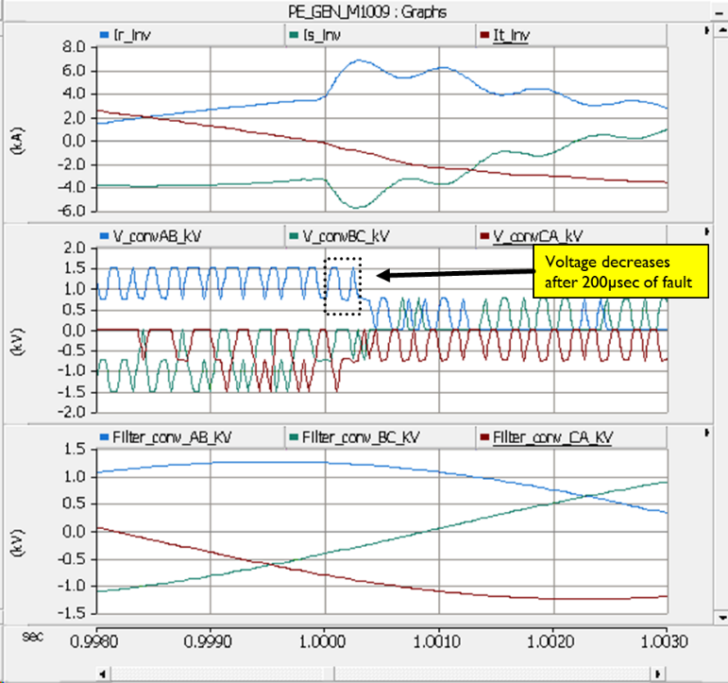
Inverter Short Circuit Response
The model file of the inverter has a current limiting response within 200 usec after the onset of the short circuit fault. The laboratory tests available confirmed a similar response.
PSCAD Model File Response (Single Phase Fault)
Laboratory Test Result (3 Phase Fault)

Slide 11
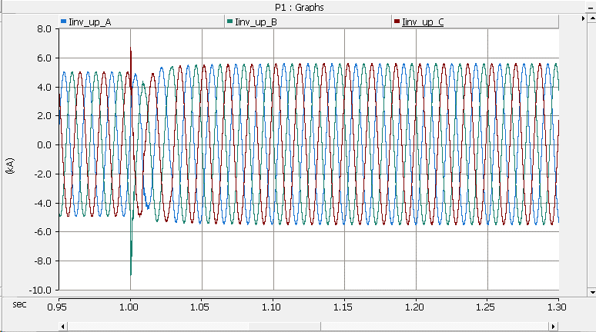
Fault Current Contribution of 68 BESS Inverters

Slide 12
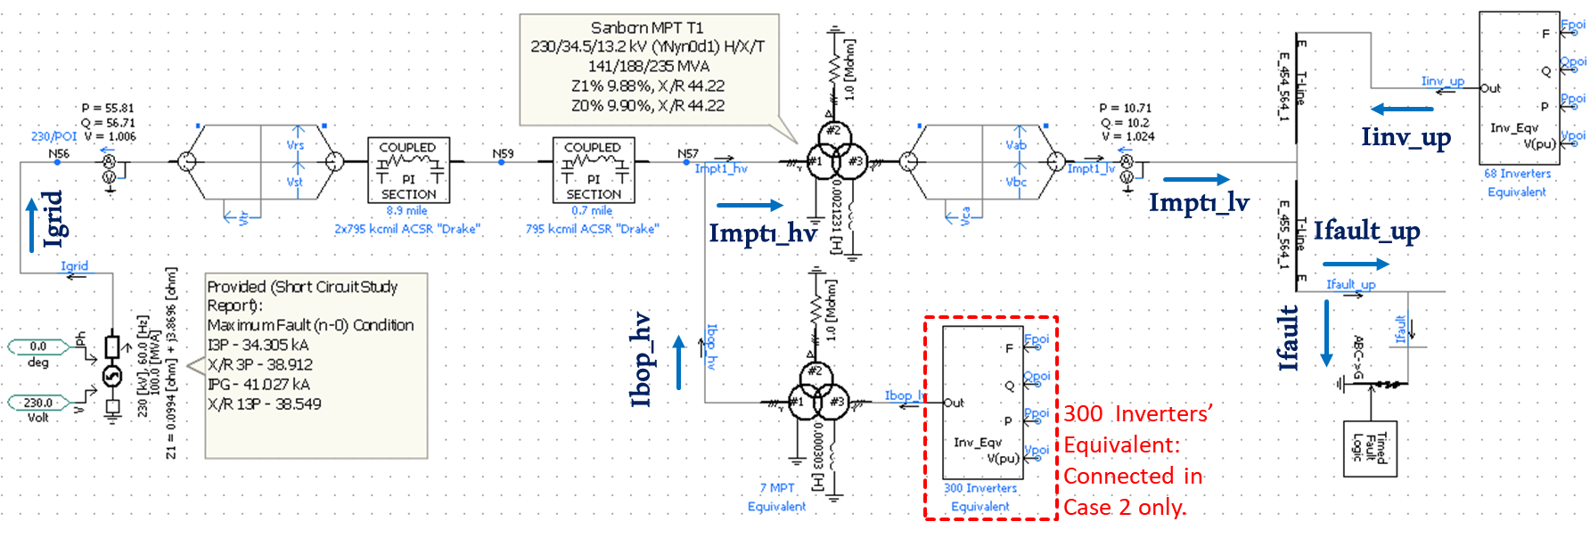
PSCAD Model File

Slide 13
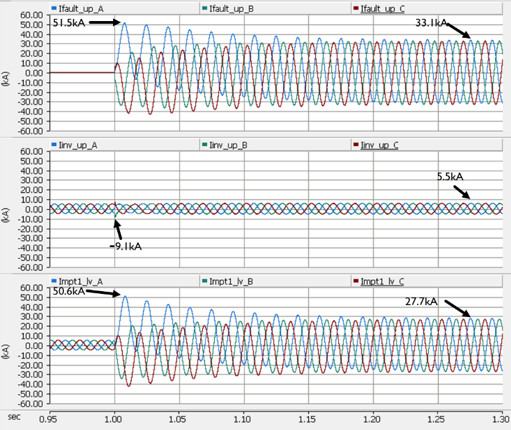
Comparison of Results

Slide 14
Results from Calculations and Simulations
The equipment was tested to confirm a rating for an asymmetrical peak fault current of 63.6 kA
The traditional phasor domain calculations result in an asymmetrical peak fault current of 63.2 kA
EMT results (inverter as simple sources) result in an asymmetrical peak fault current of 57 kA
Detailed EMT simulations (inverter switching models) result in an asymmetrical peak fault current of 53 kA

Slide 15
Conclusions
Results from EMT simulations are not strictly according to existing IEEE standards for short circuit calculation, so they could not be “signed off” by the owner’s engineer
IEEE C37.010-2016 calls for a 20% margin in switchgear sizing, and so the MV switchgear was replaced, adding significant time and schedule to the project.
The results of this paper shows that IEEE calculations effectively add 10% extra conservatism. With an additional 20% requirement, the total margin is over 30% above the proven tested capability!

